Slide 1
Using GenAI in Software Engineering
Prepared by: John Businge
john.businge@unlv.edu

Slide 2
Announcements
DP1 is due Feb 18^{th,} 2025
Lab 3 is due Feb 17^{th,} 2025
Next week (Feb 20, 2025), Jenny from the CS Advising will visit out class

Slide 3






The Hype around LLMs for Software Development
Cooled down
Notes:
The initial hype around using LLMs for software development has already started to cool down
The conversation has shifted from expecting LLMs to replace software developers (i.e., artificial intelligence) to considering LLMs as partners and focusing on where to best apply them (i.e., augmented intelligence).

Slide 4
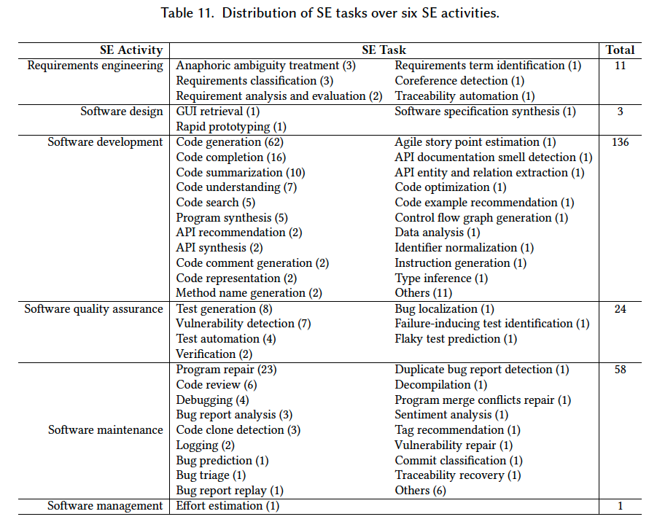
What SE Tasks have been addressed to date using LLM4SE
Hou et al. LLMs for SE: A Systematic Literature Review
https://arxiv.org/pdf/2308.10620.pdf
Analyzed 229 research papers on the subject
Read Section 6 of the paper to find which papers have addressed the SE tasks.
Notes:
Traceability automation. Software and system traceability refers to the ability to establish and maintain relationships between software artifacts, such as requirements, design definitions, code, and test cases, for product querying and development support

Slide 5
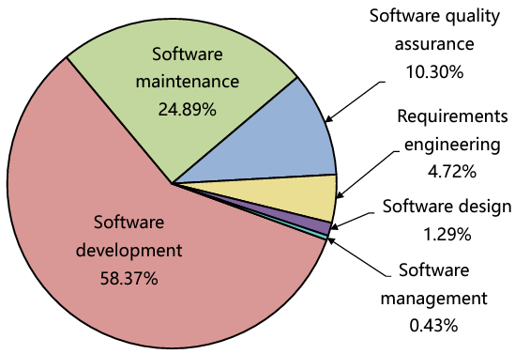
What SE Tasks have been addressed to date using LLM4SE
58.37% in software development showcases the significance of LLMs in producing code or text

Slide 6
A recent survey found that 87% of 574 GitHub developers rely on GenAI tools
Underscoring the growing demand for GenAI
https://arxiv.org/abs/2411.10877

Slide 7
Objectives of Using ChatGPT in Team projects
Enhancing Problem-Solving Skills: Utilize ChatGPT for complex problem-solving tasks.
Improving Code Quality: Enhance code readability and efficiency with ChatGPT insights.
Promoting Creativity: Inspire innovative solutions and approaches in project development.
Preparing for Industry Tools: Familiarize students with AI-powered tools for future careers.
Encouraging Collaboration: Foster teamwork through shared problem-solving with ChatGPT.
Providing Real-World Experience: Simulate industry scenarios for practical learning.

Slide 8
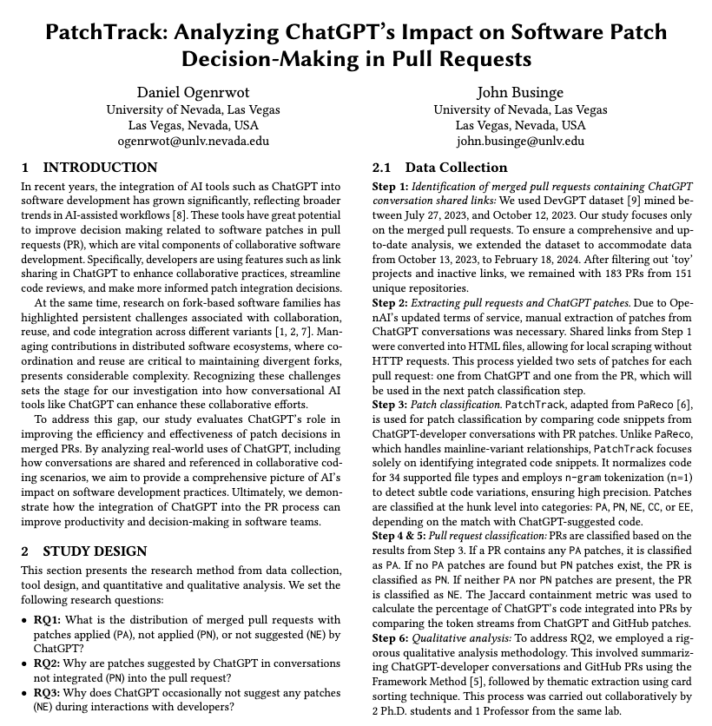
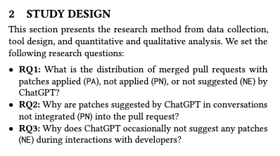
Motivation of using ChatGPT is CS472
Data Collection:
We mined 183 instances of pull requests from 151 repositories that declared code assistance from ChatGPT.
39th IEEE/ACM International Conference on Automated Software Engineering (ASE 2024).

Slide 9
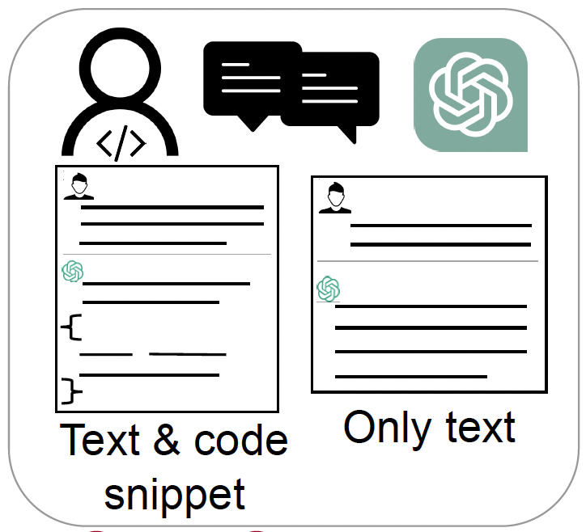
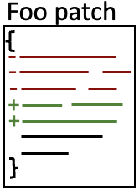
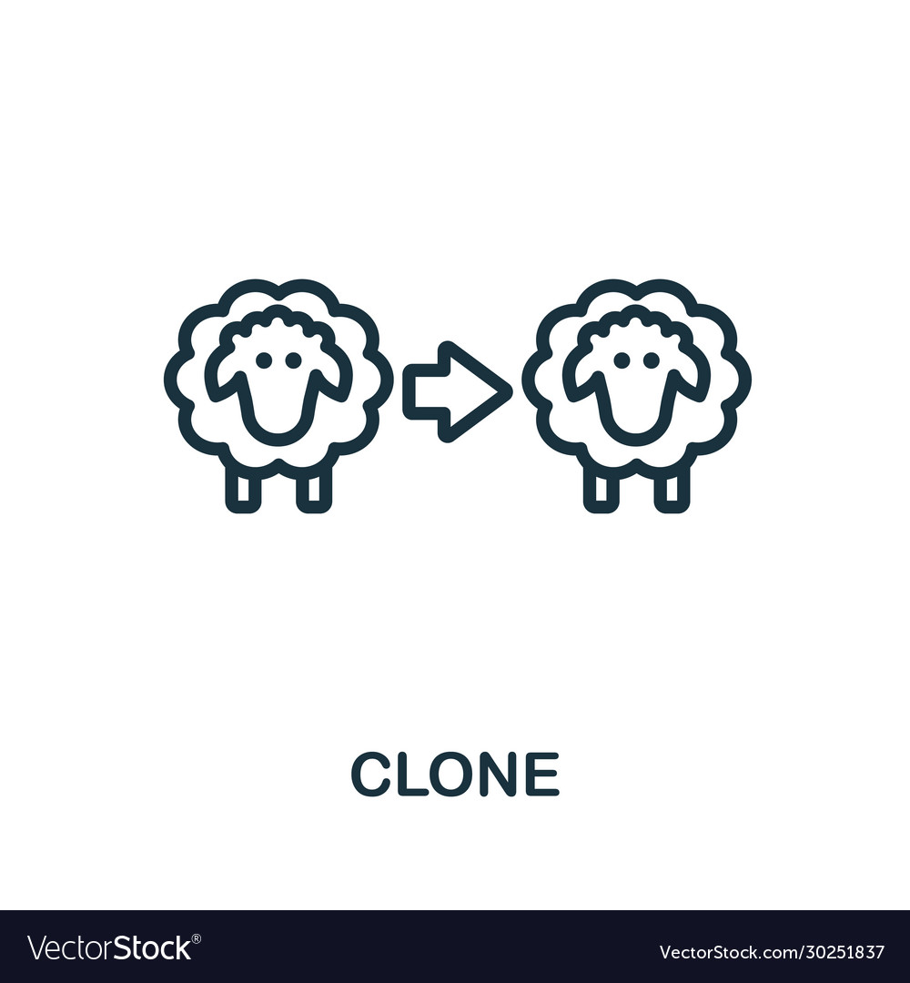
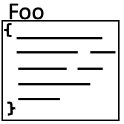


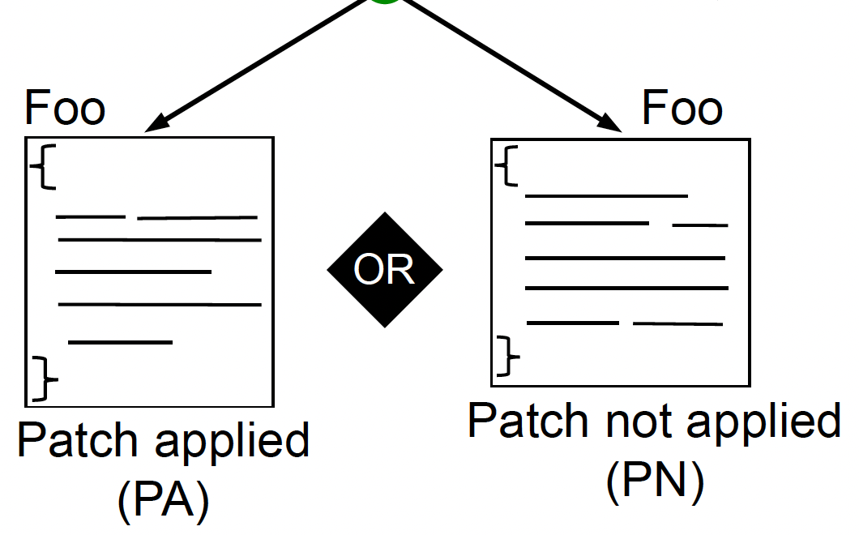
Motivation of using ChatGPT is CS472
Patch Applied (PA)
Patch not Applied (PN)
No existing patch (NE)
PatchTracker - clone detection tool
branch
Pull request
Patch not Applied
Patch Applied

Slide 10

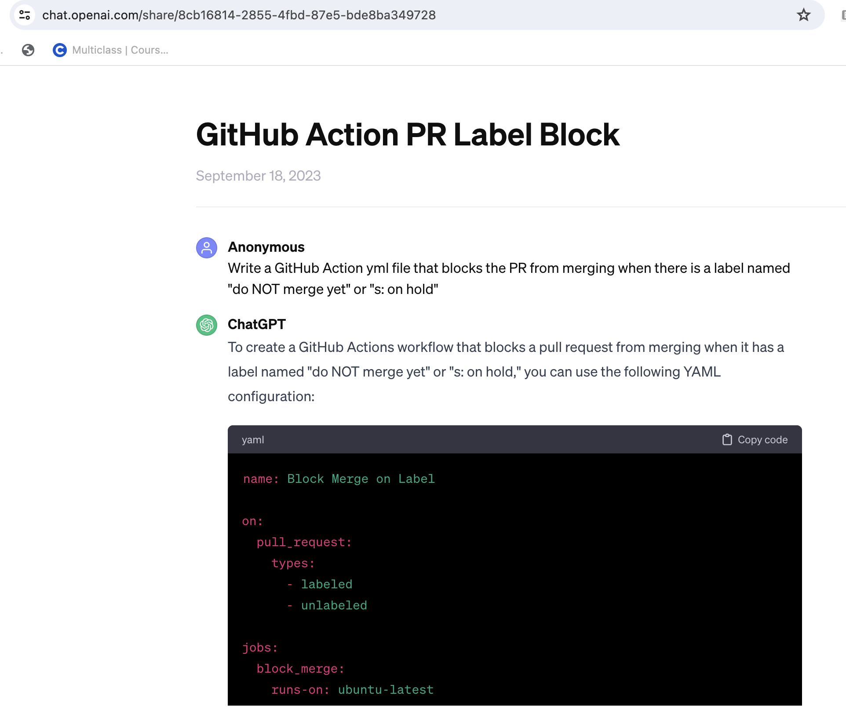
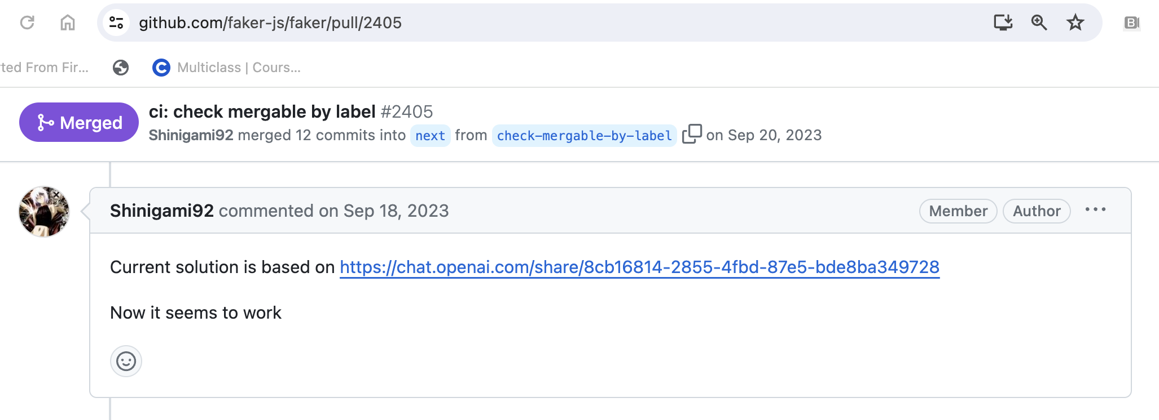
How are developers using ChatGPT to solve SE tasks?

Slide 11
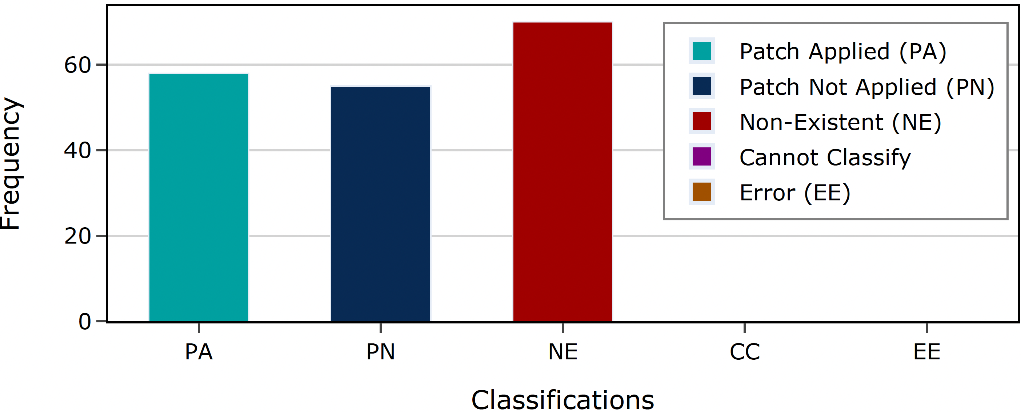
Distribution of Patch Classification Results
Implications:
RQ1 reveal that developers generally trust AI-generated patches, with 58 PA cases showing ChatGPT's effectiveness in straightforward tasks.
31% (58/183) of ChatGPT code is integrated into pull requests, with some developers fully adopting AI suggestions.
The 55 PN cases suggest a need to explore why AI suggestions are not always integrated, while the 70 NE cases highlight AI's broader roles in development.

Slide 12
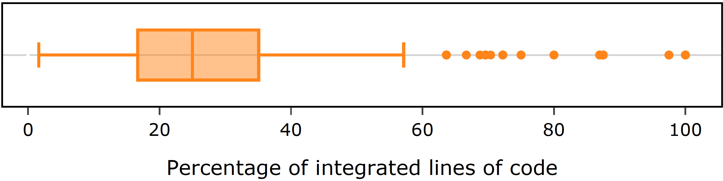
Patch Applied (PA)
Median integration rate: 25% → Full adoption of ChatGPT patches is rare.
75th percentile: 38% → Even in higher integration cases, significant modifications are common.
Developers use ChatGPT as a starting point, not a final implementation.
Selective adoption → Only code that aligns with project needs is retained.

Slide 13
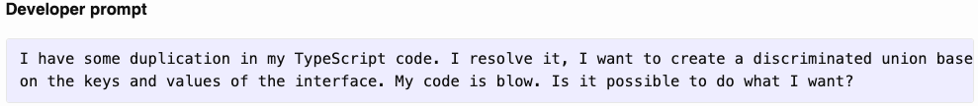
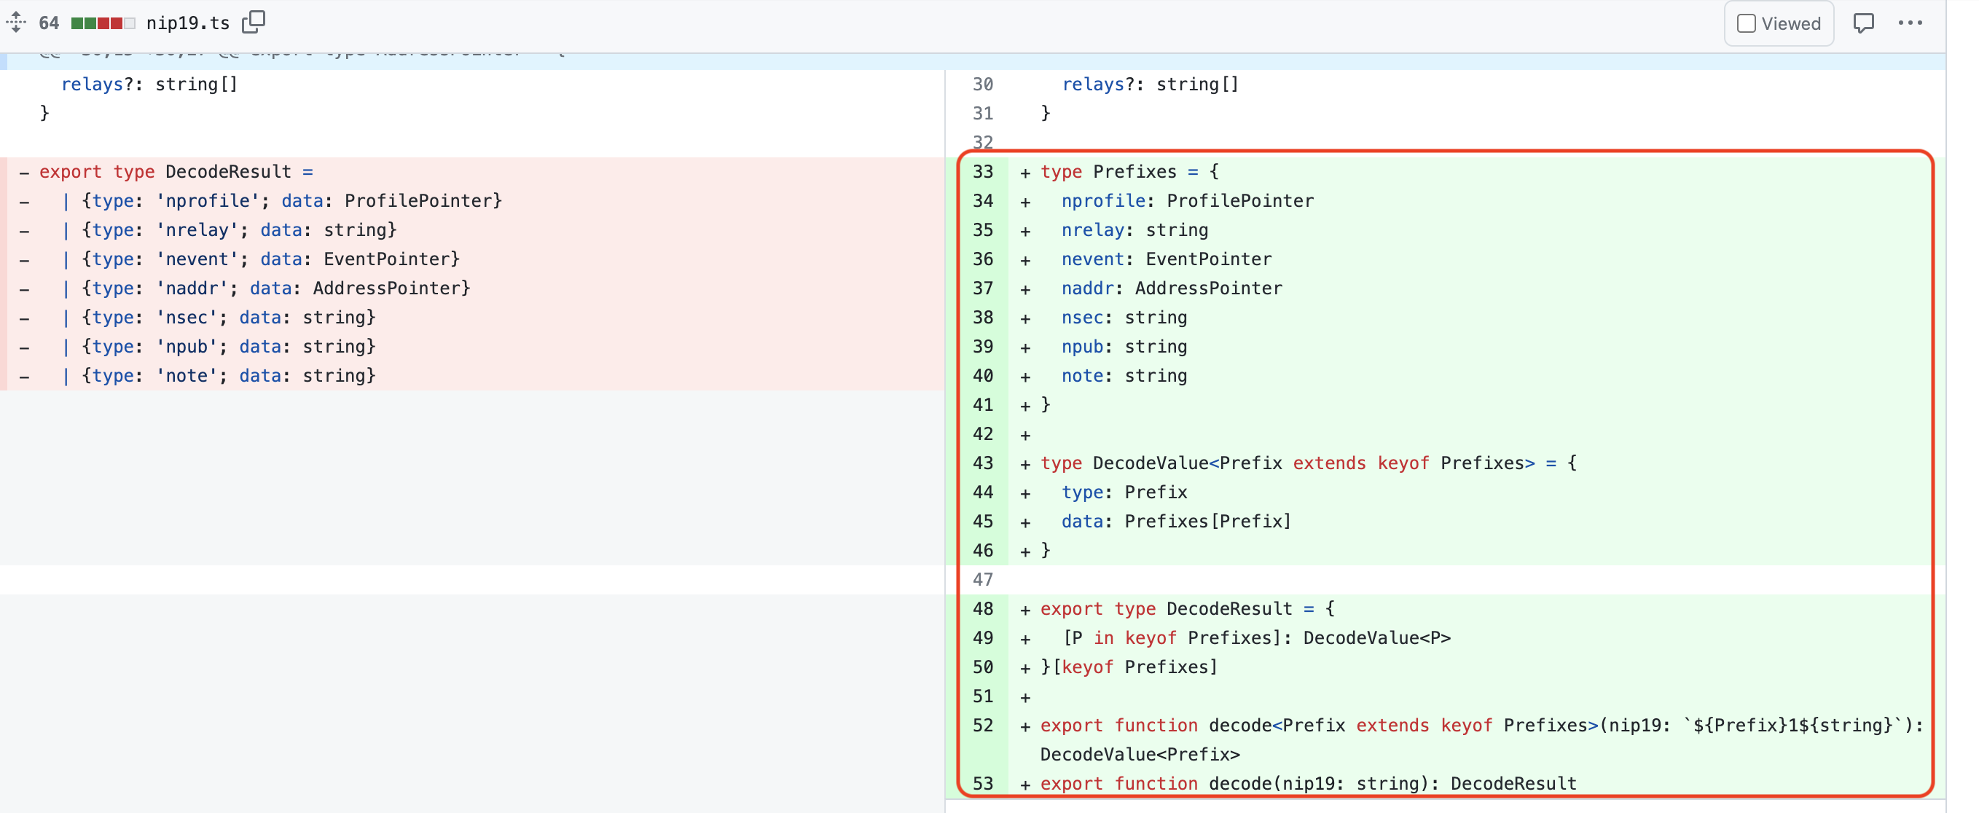
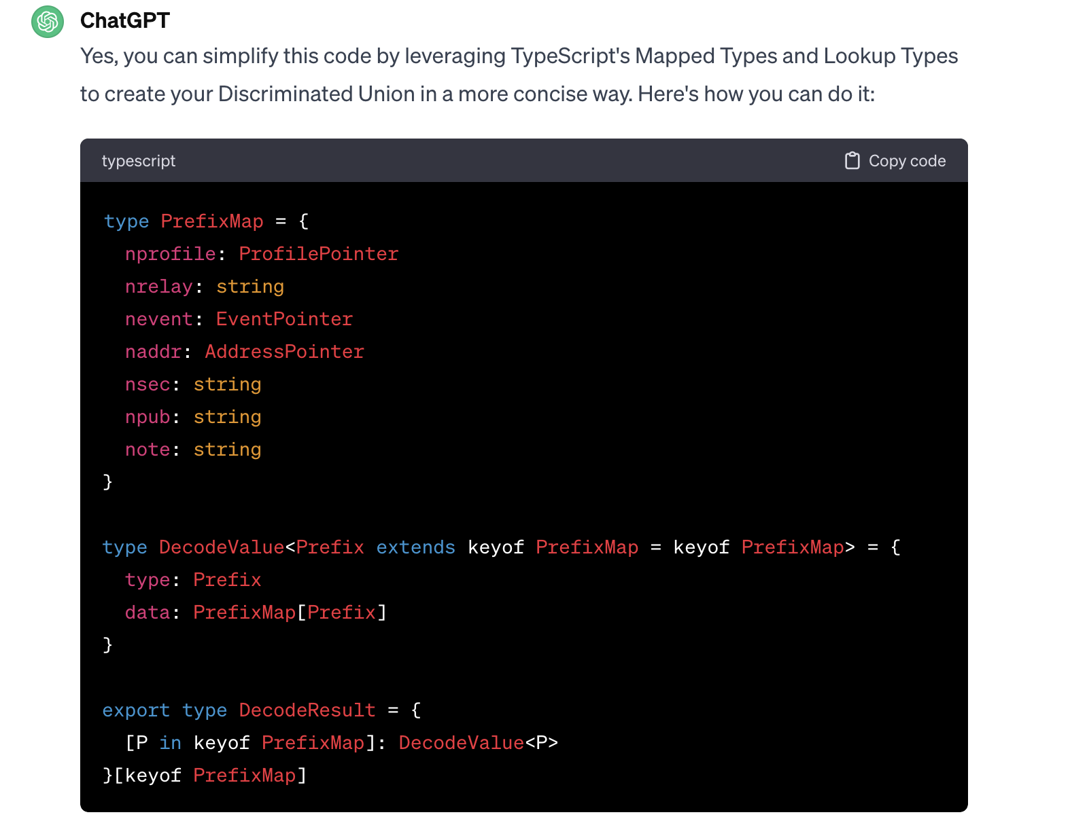
Patch Applied (PA)
Activity - Software maintenance, Task - Code duplication & refactoring
PrefixMap != Prefixes

Slide 14
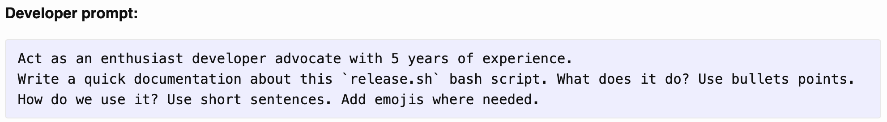
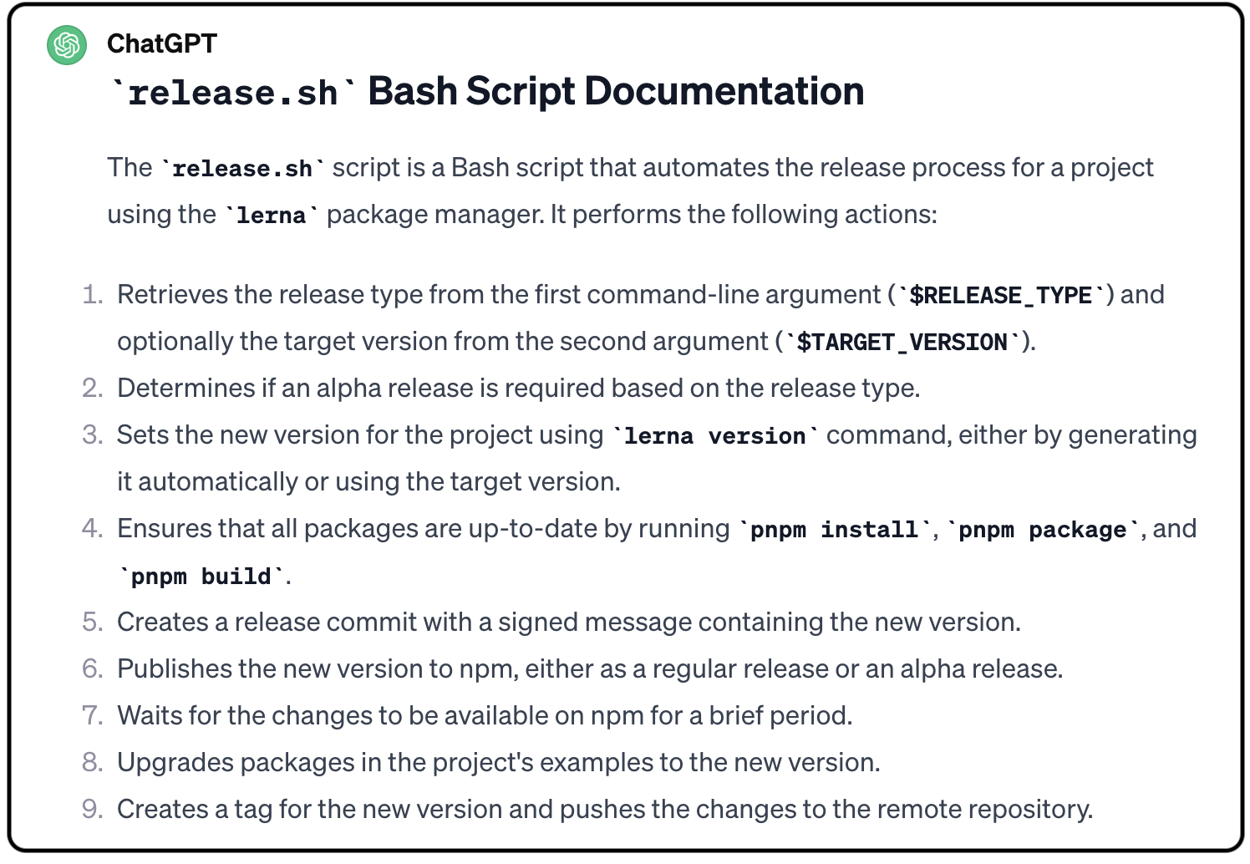
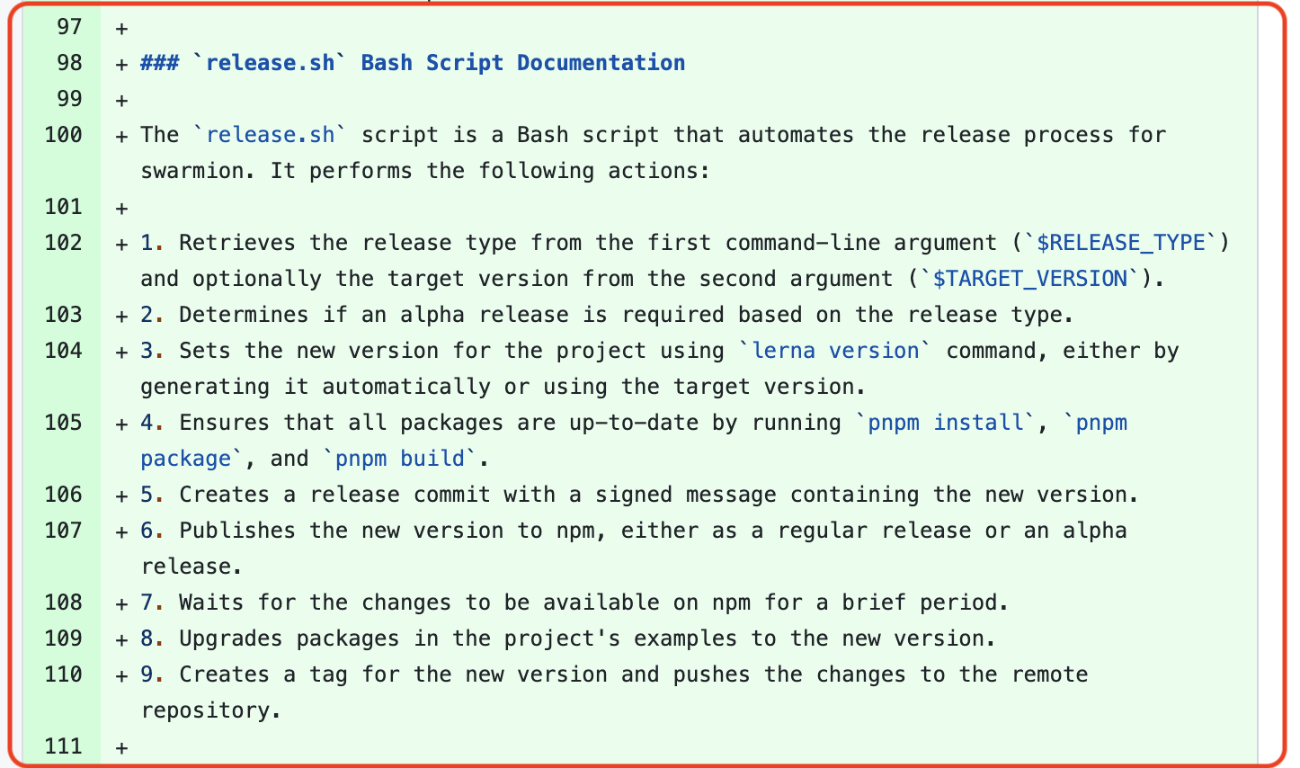
Patch Applied (PA)
SE Task – Deployment Documentation
Developer used ChatGPT to create concise, user-friendly documentation for the `release.sh’ Bash script, summarizing functionality and usage.

Slide 15
Analysis of the PN (RQ2) and PE (RQ3) cases
Step 6: To address RQ2 & RQ3, we employed a rigorous qualitative analysis methodology. This involved summarizing ChatGPT-developer conversations and GitHub PRs using the Framework Method, followed by thematic extraction using Card Sorting technique.
39th IEEE/ACM International Conference on Automated Software Engineering (ASE 2024).

Slide 16
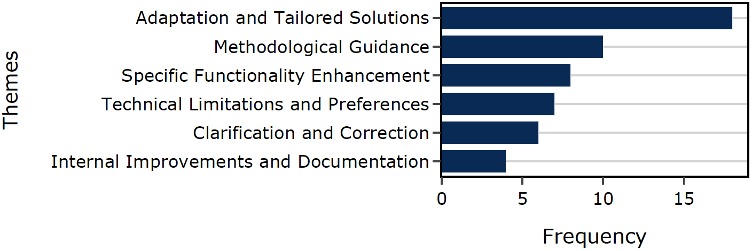
Patch Not Applied (PN)
Adaptations and tailored solutions - ChatGPT's advice informed approaches or refined solutions, not directly applied as patches. Focuses on the broader approach or strategy influenced by ChatGPT
Methodological Guidance - ChatGPT's advice informed approaches or refined solutions, not directly applied as patches.
Specific Functionality Enhancement - Enhancements informed by ChatGPT insights, tailored to specific functionality rather than direct patches.
Technical Limitations and Preferences - Non-application of patches due to technical constraints or preference for alternative solutions.

Slide 17
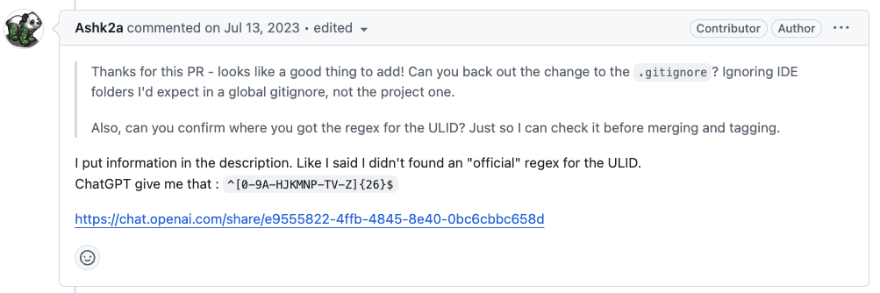
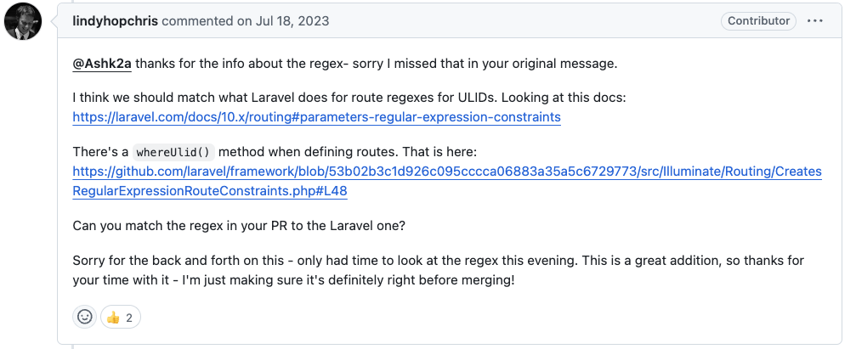
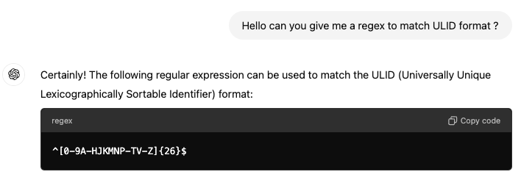

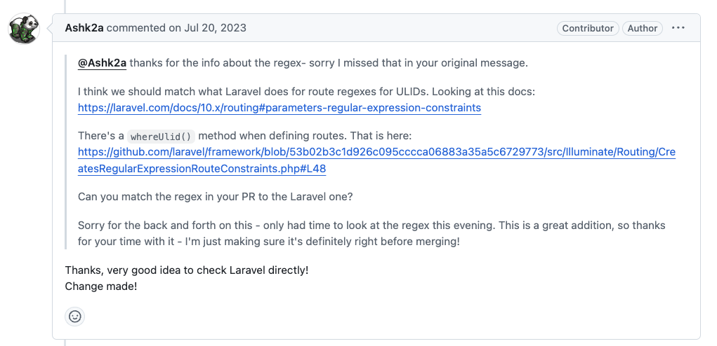
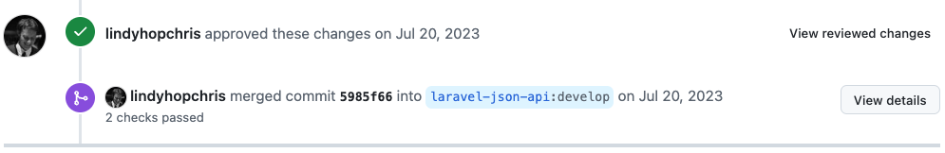
Patch Not Applied (PN) – Concrete examples
PR Author
Adaptations and tailored solutions - ChatGPT's advice informed approaches or refined solutions, not directly applied as patches. Focuses on the broader approach or strategy influenced by ChatGPT
ChatGPT’s suggestion was adapted and customized to match the project’s specific needs, demonstrating how the developer tailored ChatGPT's response based on feedback from the reviewer.
Refined Code (After ChatGPT’s Suggestion)
https://github.com/laravel-json-api/core/pull/12
https://chatgpt.com/share/e9555822-4ffb-4845-8e40-0bc6cbbc658d

Slide 18
Patch Not Applied (PN) – Concrete examples
Adaptations and tailored solutions - ChatGPT's advice informed approaches or refined solutions, not directly applied as patches. Focuses on the broader approach or strategy influenced by ChatGPT
Findings
Practitioners to utilize AI tools like ChatGPT as a starting point for generating initial solutions.
AI-generated suggestions may serve as a conceptual foundation that practitioners can refine further to suit specific project needs.

Slide 19
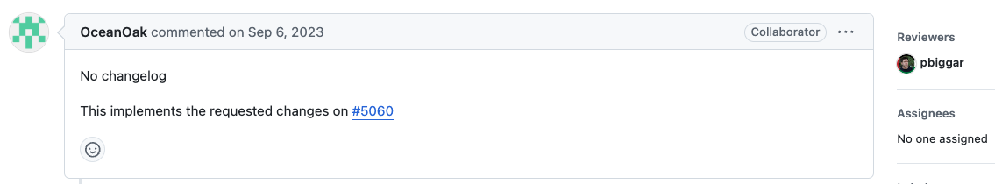
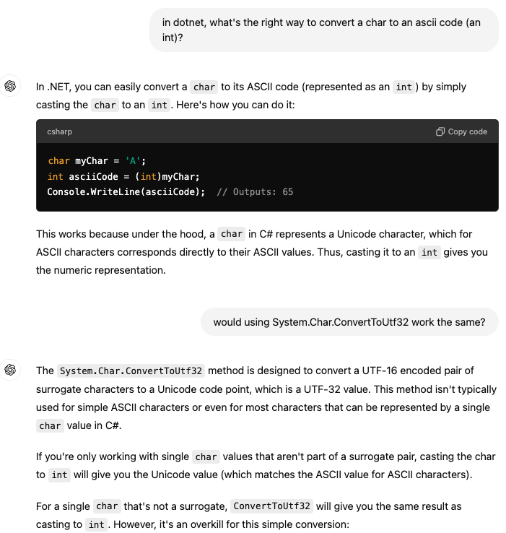
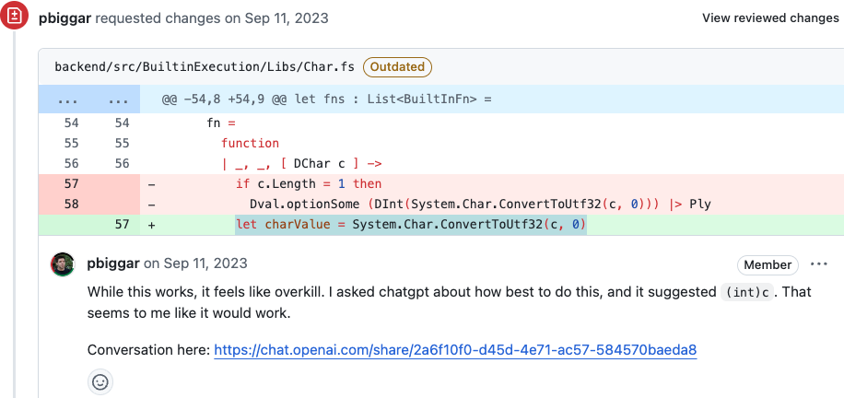
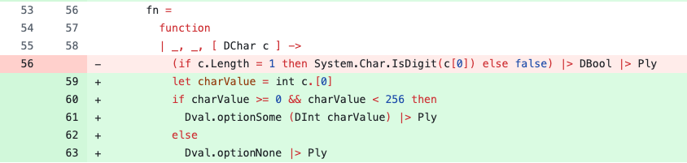
Patch Not Applied (PN) – Concrete examples
PR Author
Methodological Guidance - ChatGPT's advice informed approaches or refined solutions, not directly applied as patches.
Initial Code (Before ChatGPT's Suggestion)
Replaced
Refined Code (After ChatGPT’s Suggestion)
ChatGPT provided the developer with methodological guidance by suggesting a simpler solution, leading to the refinement of the initial approach. This interaction helped the developer improve efficiency and streamline the implementation.
https://github.com/darklang/dark/pull/5063
https://chatgpt.com/share/2a6f10f0-d45d-4e71-ac57-584570baeda8

Slide 20
Patch Not Applied (PN) – Concrete examples
Methodological Guidance - ChatGPT's advice informed approaches or refined solutions, not directly applied as patches.
Finding
Practitioners can use ChatGPT to gain alternative perspectives on coding solutions, particularly for complex code.
The aforementioned example showcases how AI can suggest more efficient approaches to achieve the same outcomes, leading to cleaner and more maintainable code.
ChatGPT can serve as a resource for best practices in coding by suggesting optimized coding patterns or reveal defect in current approaches.
Practitioners are encouraged to use AI tools as a `second opinion' for improving their initial implementations, fostering a culture of continuous improvement and optimization in development projects.

Slide 21
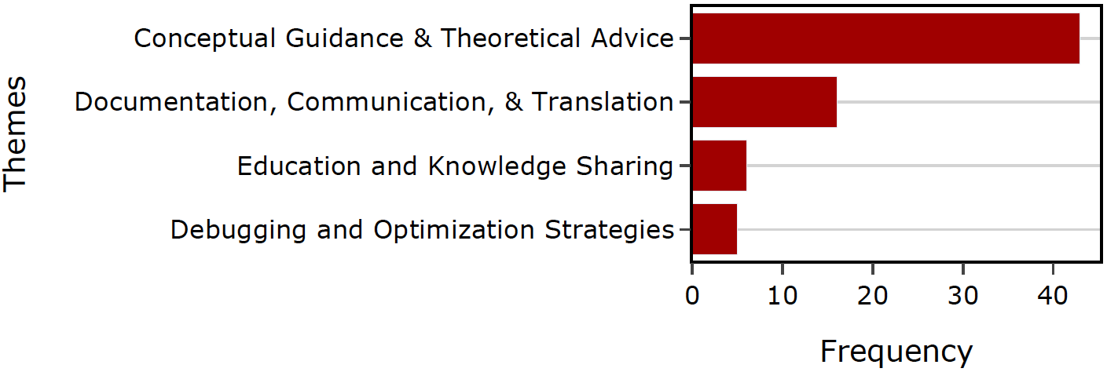
None Existing Patch (NE)
Conceptual Guidance & Theoretical Advice - focused on on programming concepts, design principles, optimization strategies, and best practices to enhance code quality, without specific code implementations.
Documentation, Communication, & Translation - Discussions focused enhancing documentation clarity, communication, and localization for better accessibility and understanding, improving overall documentation quality and effectiveness.
Education and Knowledge Sharing - Sharing knowledge on programming concepts, language features, and code functionalities to educate and improve understanding of complex topics.
Debugging and Optimization Strategies - Focused on debugging methods, performance optimization, and algorithm refinement, offering strategic insights into problem-solving without specific code examples.

Slide 22
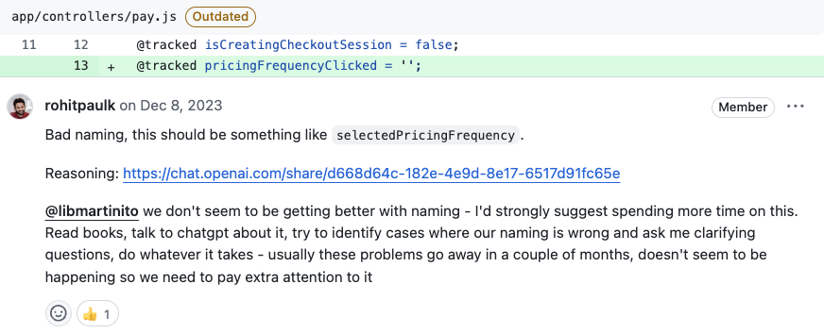
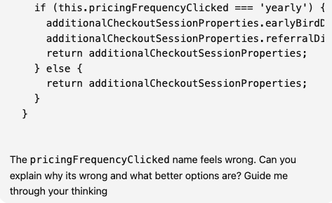
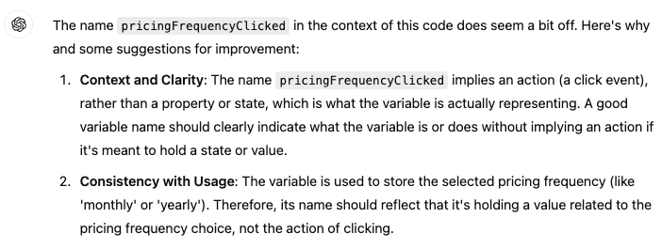
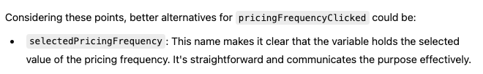
None Existing Patch (NE) – Concrete examples
PR Author
Conceptual Guidance & Theoretical Advice - focus on programming concepts, design principles, optimization strategies, and best practices like clear naming to improve code readability and maintainability. These discussions emphasize theoretical advice without specific code implementations.
Initial Code (Before ChatGPT's Suggestion)
Refined Code (After ChatGPT’s Suggestion)
The conversation provided conceptual guidance on improving code clarity by suggesting better variable names. ChatGPT recommended renaming pricingFrequencyClicked to selectedPricingFrequency to enhance readability and reflect the variable's purpose more accurately.
https://github.com/codecrafters-io/frontend/pull/1061
https://chatgpt.com/share/d668d64c-182e-4e9d-8e17-6517d91fc65e

Slide 23
None Existing Patch (NE) – Concrete examples
Conceptual Guidance & Theoretical Advice - focus on programming concepts, design principles, optimization strategies, and best practices like clear naming to improve code readability and maintainability. These discussions emphasize theoretical advice without specific code implementations.
Findings
Developers can use AI tools like ChatGPT to improve coding standards, especially in naming conventions, which greatly enhance code readability and maintainability.
Development teams should encourage learning and self-review practices, using AI to provide immediate feedback and suggestions for improving code quality and following best practices.
https://github.com/codecrafters-io/frontend/pull/1061
https://chatgpt.com/share/d668d64c-182e-4e9d-8e17-6517d91fc65e

Slide 24
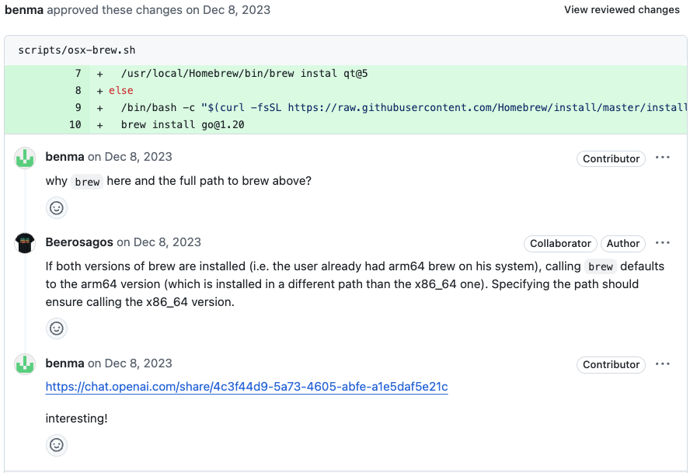
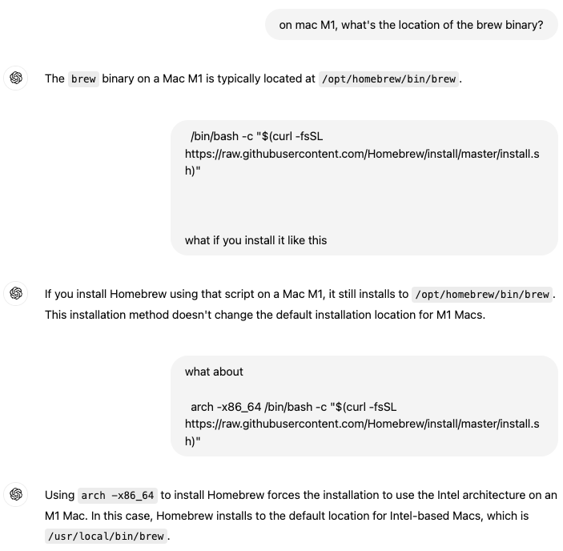
None Existing Patch (NE) – Concrete examples
PR Author
Education and Knowledge Sharing - Sharing knowledge on programming concepts, language features, and code functionalities to educate and improve understanding of complex topics..
Installation of different architectures (arm64 vs. x86_64)
The conversation shares knowledge on using the x86_64 version of Homebrew on Mac M1 systems by specifying paths and architecture flags, improving understanding of managing multi-architecture installations.
https://github.com/BitBoxSwiss/bitbox-wallet-app/pull/2415
https://chatgpt.com/share/4c3f44d9-5a73-4605-abfe-a1e5daf5e21c

Slide 25
None Existing Patch (NE) – Concrete examples
Education and Knowledge Sharing - Sharing knowledge on programming concepts, language features, and code functionalities to educate and improve understanding of complex topics..
Findings
Developers can use AI tools like ChatGPT to continuously learn and stay updated on new technologies, programming languages, and system architectures.
By querying AI on specific technical topics, developers can improve their problem-solving skills and deepen their understanding of the systems they work with.
https://github.com/BitBoxSwiss/bitbox-wallet-app/pull/2415
https://chatgpt.com/share/4c3f44d9-5a73-4605-abfe-a1e5daf5e21c

Slide 26
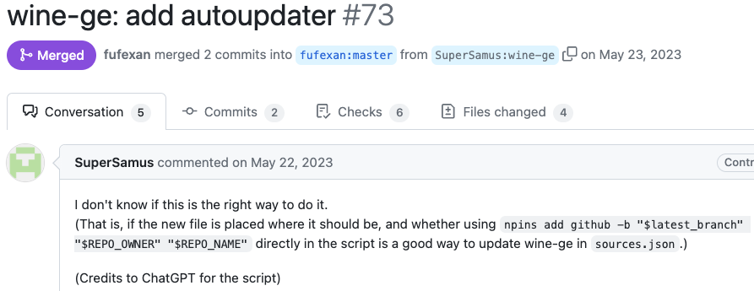
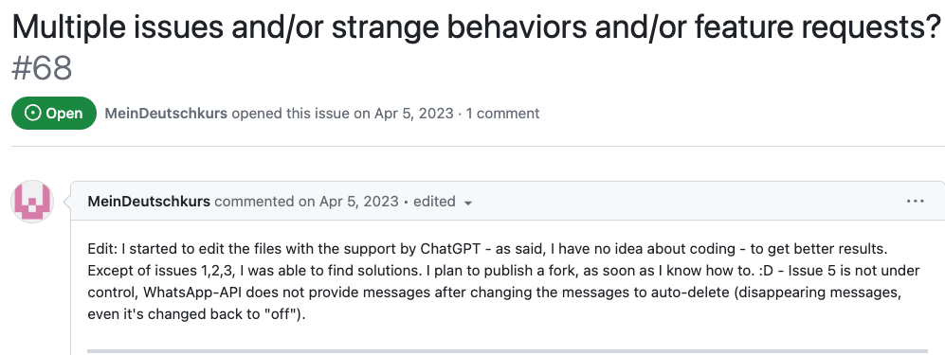
Ownership of AI generated code
These two cases are are representative of those instances in which the contributor explicitly states to be unsure about what was accomplished using ChatGPT.
https://github.com/fufexan/nix-gaming/pull/73
https://github.com/danielgross/whatsapp-gpt/issues/68

Slide 27
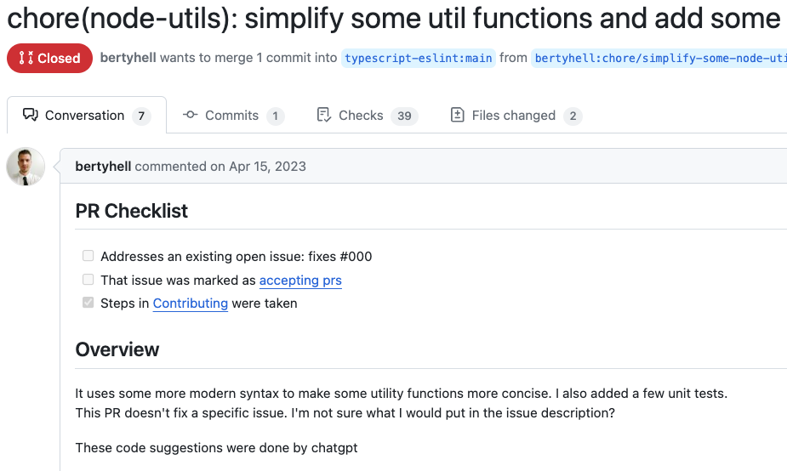
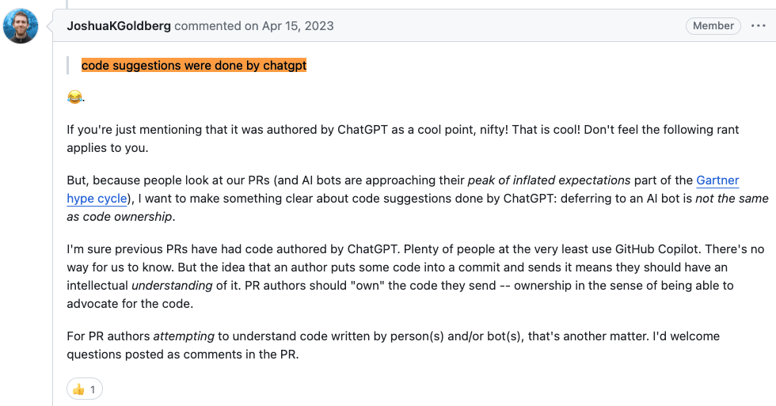
Ownership of AI generated code
https://github.com/typescript-eslint/typescript-eslint/pull/6915
In your team project you should define guidelines for projects’ contributions including AI-generated code,
e.g., you may decide to only welcome AI-generated code from users that are confident in assessing the correctness of the contributed code.
Conduct a thorough peer reviews on code suggested by LLMs

Slide 28
LLM Hallucination
While large language models can generate fluent and coherent text on various topics and domains, they are also prone to just "make stuff up". Plausible sounding nonsense!
What
Why
Minimize
Deviation from facts or contextual logic
Minor inconsistences
Completely fabricated
Contradicting statements
Data quality
Trained on internet data
E.g., Reddit and Wikipedia, right?
Semantically, LLMs have no idea what its saying.
They are just doing Math.
Factually, it can occasionally make errors.
Clear and specific prompts
Structured prompting
Role-based prompting

Slide 29
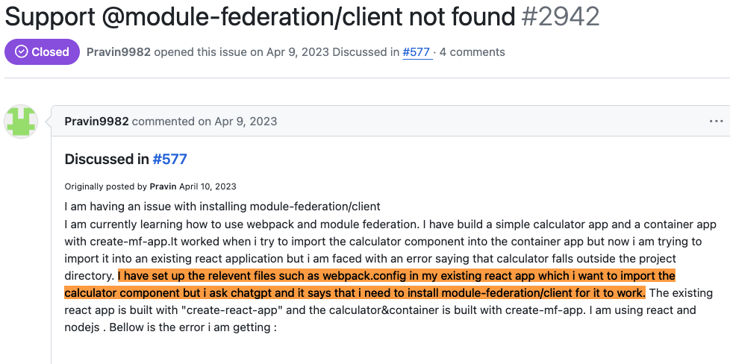
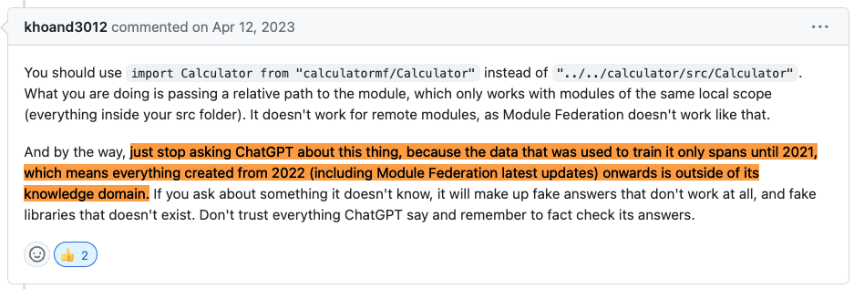
LLM Hallucination – What and Why
In modern development, ChatGPT's pre-2021 training restricts its understanding, resulting in speculative or inaccurate responses ("hallucinations") regarding newer technologies like Module Federation.
https://github.com/module-federation/module-federation-examples/issues/2942

Slide 30
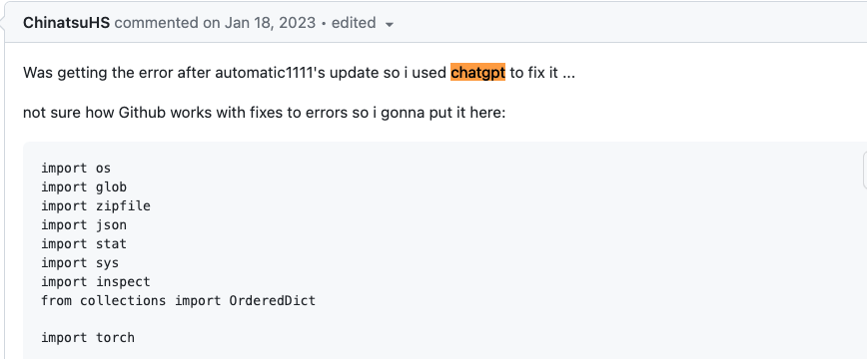
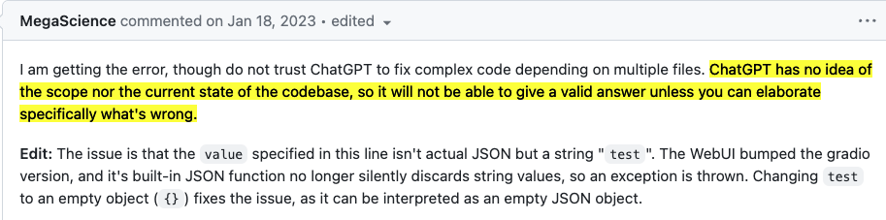
LLM Hallucination – What and Why
ChatGPT hallucinated in this context because it lacks real-time awareness and understanding of the specific problem being discussed. The suggestions were based on general patterns or associations it learned from its training data, rather than a precise understanding of the developers' current task or the relevance of the library to the issue at hand.
Developers should avoid relying solely on ChatGPT for guidance on cutting-edge or domain-specific topics beyond its training data, especially in rapidly evolving fields like software development. Instead, they should verify ChatGPT's suggestions with up-to-date sources or with domain experts to ensure accuracy and relevance.
https://github.com/kohya-ss/sd-webui-additional-networks/issues/43
These are the kind of collaborations your teams should be involved in to address ChatGPT’s hallucinations

Slide 31
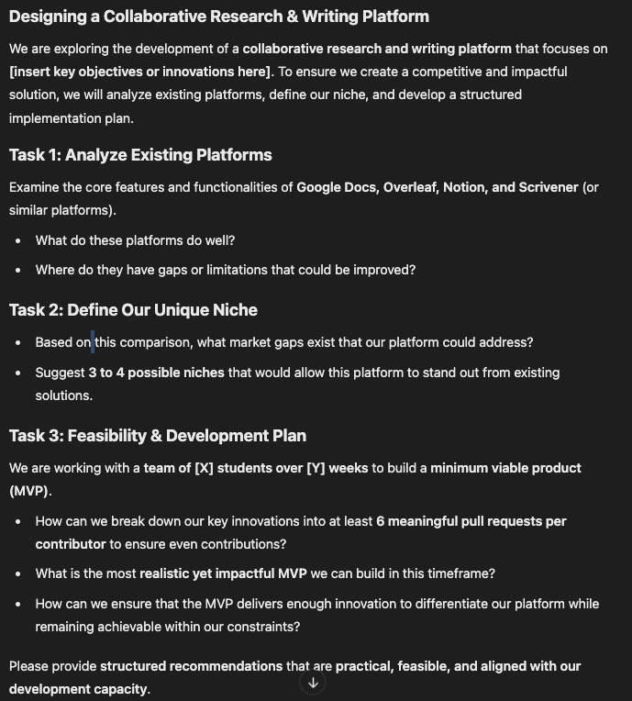
LLM Hallucination – Minimize – Good prompts
Task-Based Prompting
The prompt is divided into clear tasks that direct users to complete specific activities.
Each task has a well-defined goal, reducing ambiguity in responses.
This helps in breaking down a complex problem into manageable steps.

Slide 32
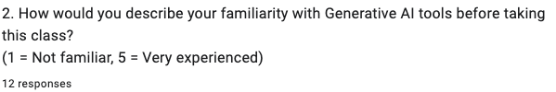
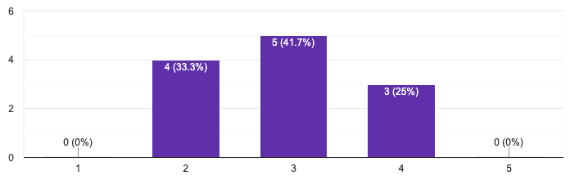
Last Semesters Survey – Use of GenAI
12/17 responses = 70.6%

Slide 33
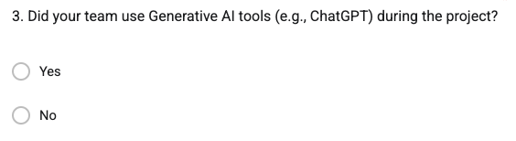
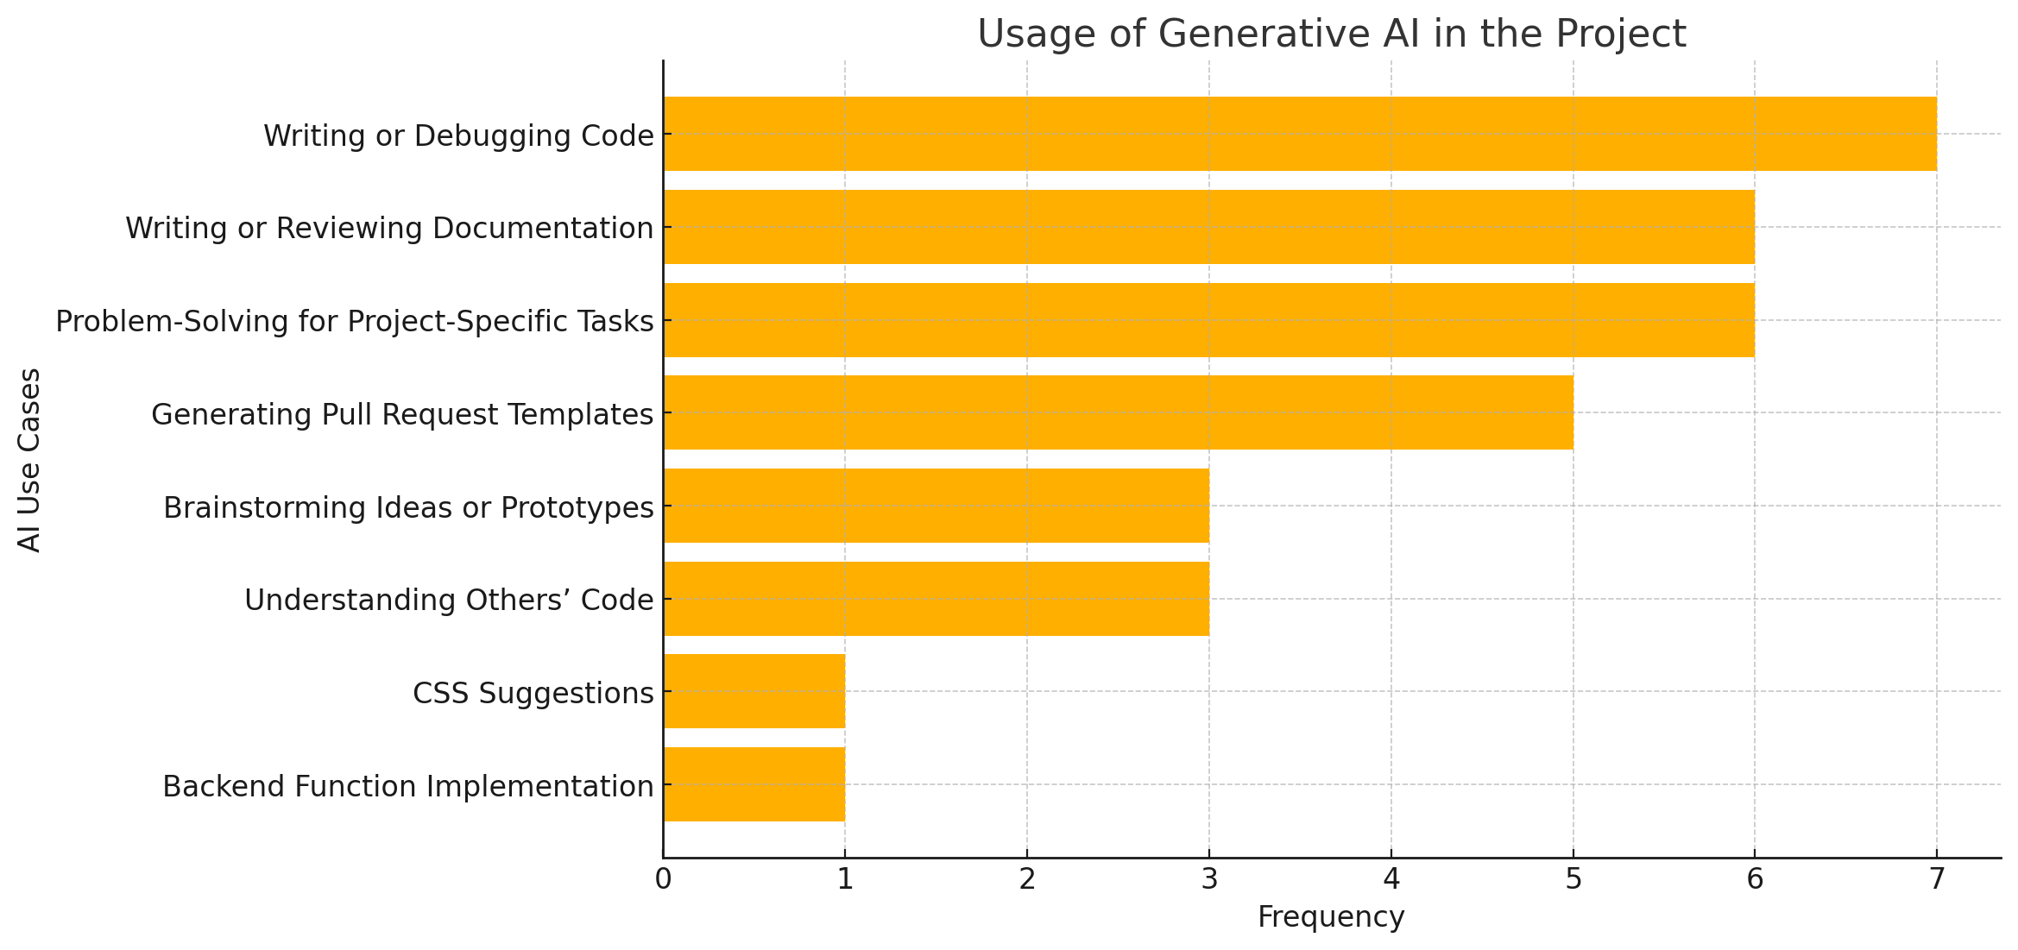
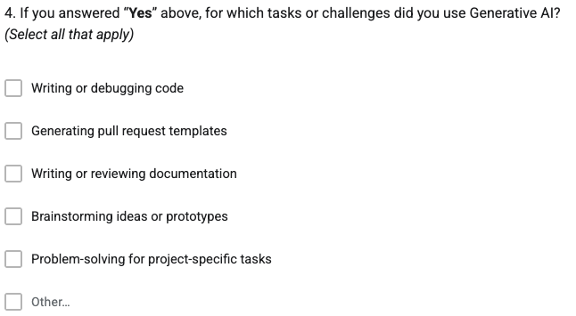
Last Semesters Survey – Use of GenAI

Slide 34


Last Semesters Survey – Use of GenAI
Interactive
Interactive

Slide 35


Last Semesters Survey – Use of GenAI
Interactive

Slide 36

Last Semesters Survey – Use of GenAI
Interactive
Sometimes AI would give suggestions that don't align with the project goals. If code gets merged that was written using AI and it doesn't have proper documentation or the author lacks an understanding of the code, it makes things difficult down the line. Once advancements are made to your project and you need to debug/refactor the AI code, it will be harder to understand.

Slide 37

Last Semesters Survey – Use of GenAI
Interactive

Slide 38


Last Semesters Survey – Use of GenAI
Interactive

Slide 39


Last Semesters Survey – Use of GenAI
Interactive

Slide 40
Conclusion
Integrating ChatGPT into your team projects offers exciting opportunities but also comes with challenges. By fostering collaboration, we can harness the potential of ChatGPT while developing critical thinking skills and ensuring the quality of our solutions.

